Slide 1



AIRLINES RESERVATION SYSTEM

Slide 2


PROJECT ASSOCIATES
Parthana Ghosh (18871021049)
Ishita Naskar (18871021054)
Subhajit Naskar (18871021057)
Unnati Saha (18871021060)
MASTER OF COMPUTER APPLICATION

Slide 3
CONTENTS
Topic and Members..
Project Introduction
Brief discussion on project topic (Why have you chosen the project topic?)
Main Objective of the application
Feasibility Study
System Requirement Specification
a. Functionality And Advantage Of The Project
b. Non Functional Requirement
System Design: ERD along with table structure, DFD, Use case diagram (must for web development), sequence diagram, activity diagram (if required).
Testing Strategies and test results
User manual: Screen Shots of the functionality of the project.
Limitation and scope of the project.

Slide 4
INTRODUCTION
Computer plays an important role in our daily life. Anything we want we can get only in one mouse click. Speed, reliability and accuracy of the computer make it a powerful tool for different purposes. A very important and basic need of today’s modern business world is the quick availability and processing of information using computer. One can easily get the type of required information within a fraction of a second. The project that I have taken is also in this category which is used in our daily life whenever we want to purchase some items we can easily get them at our home.

Slide 5
BRIEF DISCUSSION
The purpose of the project entitled as  AIRLINES RESERVATION SYSTEM  is to computerize the Front Office Management of Airport to develop software which is user friendly simple, fast, and cost effective. It deals with the collection of passengers information, journey details, etc. Traditionally, it was done manually. The main function of the system is register and store passengers’ details and their others detail and retrieve these details as and when required, and also to manipulate these details meaningfully System input contains passengers’ details, journey details, while system output is to get these details on to the screen. The AIRLINES RESERVATION SYSTEM can be entered using a username and password. It is accessible either by an administrator or passengers. Only they can add data into the database. The data can be retrieved easily. The data are well protected for personal use and makes the data processing very fast.

Slide 6
Main Objective of the Application
The objective of project on Online Airline Booking system is to developing a React Js and Node Js based automated system, which will cover all the information Related to the Airline Ticket System. For example – Ticket Reservation, Fare Tracking, Discounts, food, and many more. And we also use Mongo DB. So by this React Js based automated system a user want to buy Ticket then it only a mouse click away to purchase these products.

Slide 7
Feasibility Study
The feasibility study of this project comprise of the following
Economic Feasibility
The cost centers in the system development as well as operation are trivial. The major can be network, internet and the software required for coding. The software used for the development of the proposed system is React and Js. In terms of wallet our product is in well reach of pocket.
Technical Feasibility;-
Technical feasibility centers on the current system and to what extent it can support the proposed system, it includes current computer system specifications such as hardware, software etc. it also involves financial considerations to accommodate the technical enhancements. If the budget is serious constraint then the project is judged not feasible. Though the system is developed in the generalized form, which covers all the procedures and operations carried out in an internet based solution. The version used in the system is PHP and MySQL. MySQL can manage large amount of data and is simple and secure. Using PHP helps us to design the look of our application.
Operational Feasibility:-
In this we determine what change will be brought in system, new skills required and other human organization and political aspects. Each user can easily use our site. However it is desirable that the user has the basic knowledge of the computers. Without making any changes in the rules and regulations of the existing system proposed system can easily adopted.

Slide 8
System Requirement Specification
a. FUNCTIONAL REQUIREMENTS
Functional requirements define the fundamental actions that must take place in the software in accepting the inputs and in processing and generating the outputs. These are listed as “shall” statements starting with “The system shall….
Login Module– This module is provided for administrator and users such as Product buyer and seller who have registered themselves in the system. These login are provided according to the need of the systems.
▪ Input – User id and password
▪ Process – After entering user id and password by user process of validation occur to identify whether user id and password is available in database or not.
▪ Output – Registered user can access website and can use the services. Administrator Module – The administrator is provided with password and login-id with which he/she can access the system. Administrator is provided right of maintaining the database, verifies registered users.
▪ Input – Login id and password.
▪ Process – Process of validation will occur.
n will occur.
▪ Output– Only genuine user can access services provided by website.

Slide 9
Output– Administrator will maintain the database and will perform Product seller process. Search Module– In this module we are going to provide facility for Product buyer to search for Products according to their specified categories so that users can search for Products easily
. ▪ Input- Initial letter of Product, with the help of keywords and with the help of Brand name.
▪ Output- Information about Products.
▪Process-Online Shopping Portal Page 20 User Module– As users are the main visitor of site, the following facilities are available through this module. Can search the Products according to their need Can order online books and pay via credit or atm card or PayPal. Can get information about Products
. ▪ Input – User Id and password
▪ Process– Process of validation will occur.
▪ Output– Only genuine user can access services provided by website

Slide 10
Non Functional Requirement
Performance Requirement
The performance of the product mainly depends on the speed of Internet connection. If the user wants hard real time response, then this is definitely not the product to go for.
Safety Requirements
The electrical connection to the devices is critical and should be done according to the standards to avoid any short circuits.
Security Requirements
We aim to provide high security features like encryption to the user accounts to provide security from illegal hacking and gaining access to the system

Slide 11
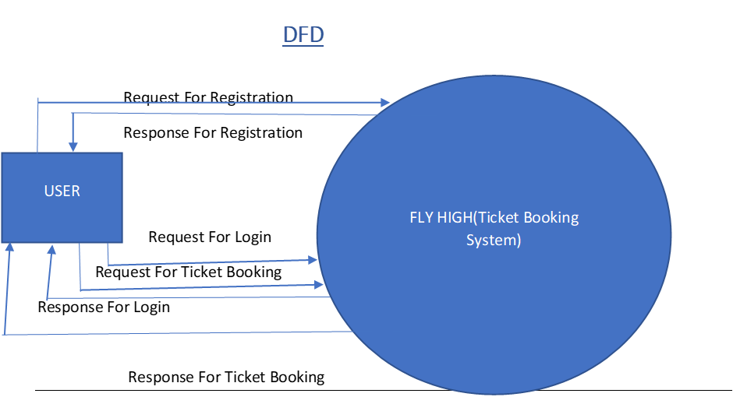
System Design: Data Flow Diagram
Zero Level DFD---Airlines Reservation System

Slide 12
Second Level DFD---Airlines Reservation System

Slide 13
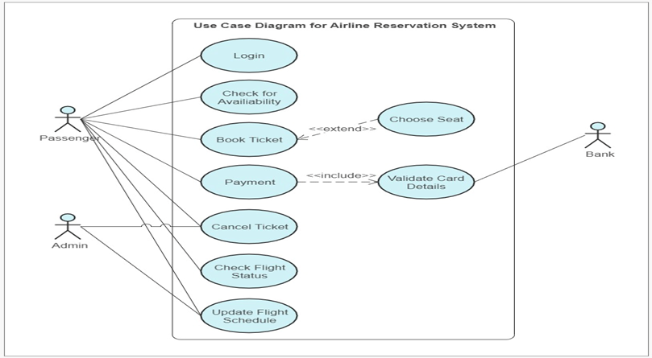
USECASE DIAGRAM

Slide 14
GNATT CHART
Task | Nov’22 | Dec’22 | Jan’23 | Feb’23 | Mar’23 | Apr’23 | May’23
Planning
Research
Design and development
Implementation
Follow-up and action
Task | Nov’22 | Dec’22 | Jan’23 | Feb’23 | Mar’23 | Apr’23 | May’23
Planning
Research
Design and development
Implementation
Follow-up and action

Slide 15
System Design: ERD along with table Structure
Name:
Address:
Phn Number:
Dob:
Nic:
Passport No:
Nationality:
Destination:
Airline:
Day of Dep:
Time:

Slide 16
Testing Strategies and Test results
Testing is the process of executing a program with the intent of finding errors. Although software testing is itself an expensive activity, yet launching of software without may lead to cost potentially much higher than that of testing, especially in systems where human safety is involved. Effective software testing will contribute to the delivery of higher quality software products, more satisfied users, and lower maintenance costs, more accurate and reliable results. Software testing is necessary and important activity of software development process.

Slide 17
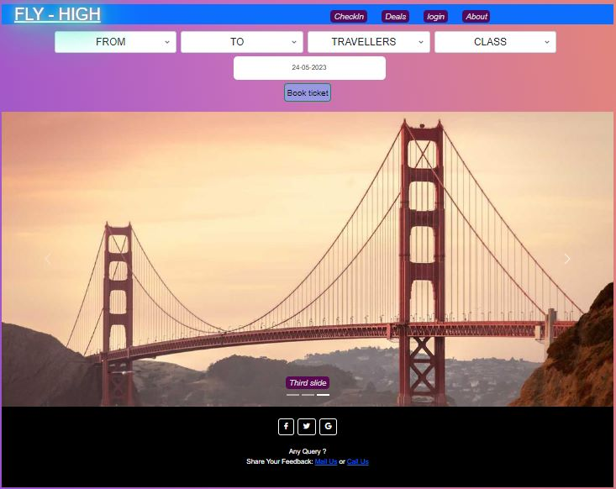
User manual: Screen Shots of the Functionality of the Project.

Slide 18
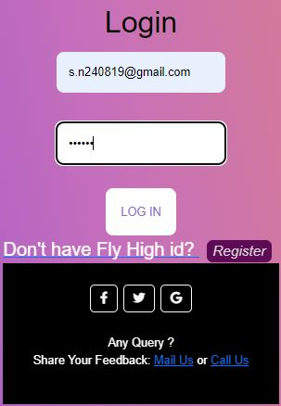
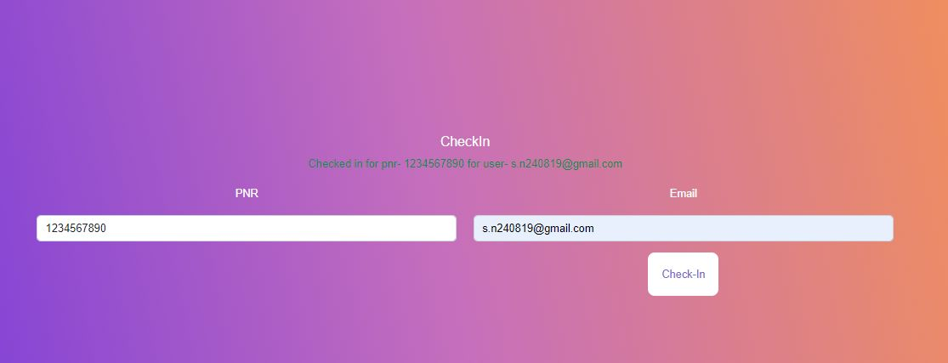

Slide 19
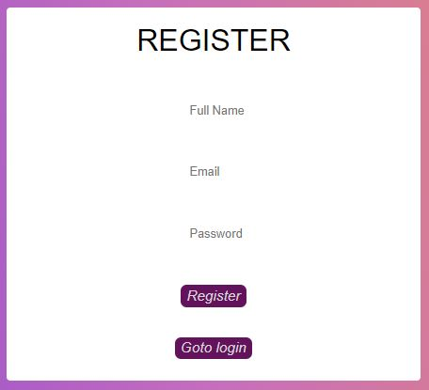
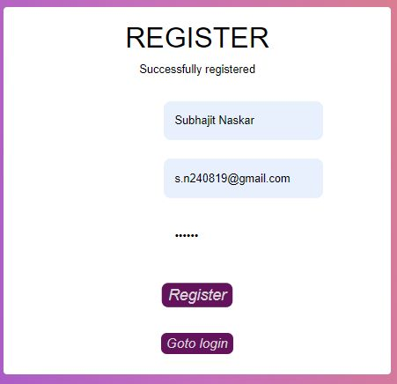

Slide 20
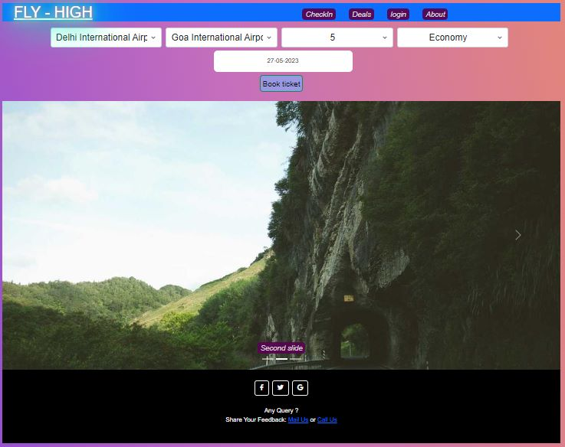
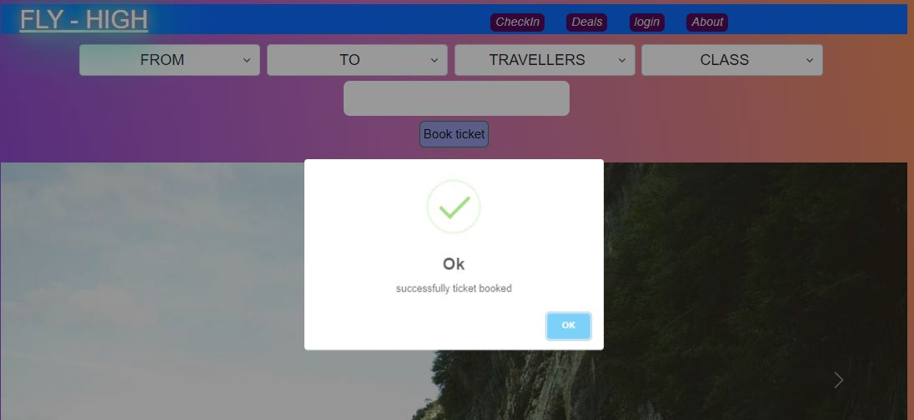

Slide 21
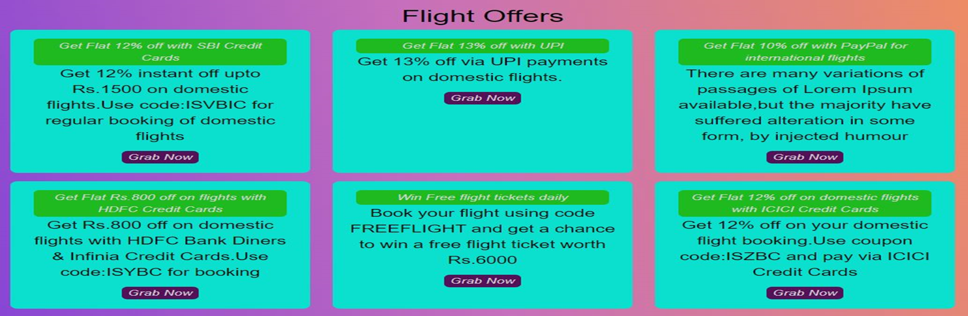

Slide 22
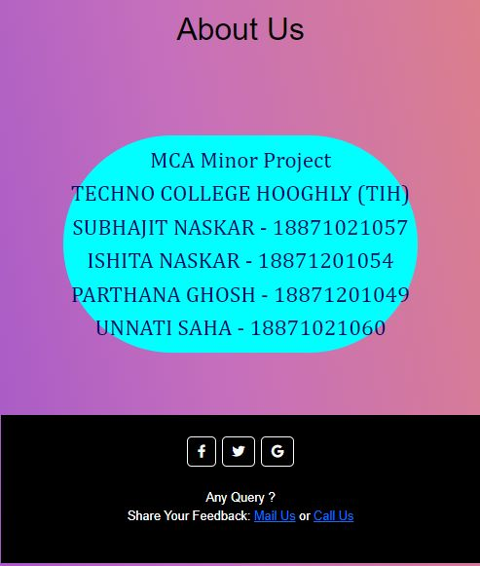

Slide 23
Limitation and scope of the Project
Although We have tried to do the best and try to do all the things that are possible in an Online System, but still the system contains some of the limitations. The reason of these limitations is the time constraints. Time is the major problem. I Have to deliver the project in a particular time period. That’s way I have to leave Some of the topics that actually I want to cover, I am still working on this software And my next goal is to remove these limitations and develop a more efficient and Elegant system.
Limitations of the System:
1.This project does not give the information about the stock (quantity) present within the shop.
2. This project does not create monthly, yearly Reports. After removing these and other minor limitations I hope this project will very efficient and effective.

Slide 24
CONCLUSION
Online Airline Booking System is a challenging project because it’s a new idea. At start We didn’t know how the interface would be. Though it’s challenging to build up a new project. We have built it.

